Slide 1
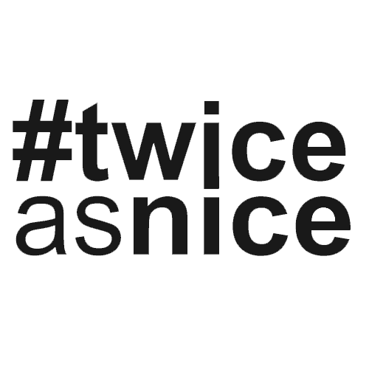
CASE STUDY
ENGINEERING A SUCCESSFUL LOCAL SEARCH
THE CLIENT
The client is a plastic manufacturer in Pennsylvania. With a comprehensive product list, they need local staff ready to handle their growth and production operations.
From the Client Manager
THE ROLE
“We’re dealing with unpredictable situations just like anybody else, but good recruiting teams need to be prepared for that. Keeping a strong active pipeline is just what we did, and that’s how we approach every search, especially for great clients like this.”
Jessica Riney Client Manager
The Engineering Manager would need to be a leader and help guide a small engineering team. The client needed an engineer who could harness the diverse talent they already have to create a cohesive unit. They also needed a strong communicator who could strategically create and translate a new product vision into a production plan.
THE CHALLENGE
The candidate needed to have an outgoing personality to lead a team, along with a variety of engineering experience. Finding the right skillset can always be a challenge, but when the candidates need to be local, there’s an extra layer of difficulty.
HOW #TWICEASNICE PARTNERED
Region
Northeast
#twiceasnice Recruiting isn’t a local recruiting firm, but we find local placements every day. With our tried-and-true, tested method, we interviewed 14 candidates and presented seven to the client for review. Despite the initially sourced candidate being on track for a 30-day placement, they found a new role. We immediately went back to the drawing board to source another winning candidate for our client.
Industry
Manufacturing
Role
Engineering Manager
#TWICEASNICE RESULTS
While this wasn’t our shortest search, the client had their accepted engineering manager introduced to them on day 80 with a placement on day 100. Once the winning candidate was introduced, it was just under a month to an accepted offer.
#twiceasnice Savings $11,880
WE’D LIKE TO PARTNER WITH YOU
Placement Guarantee 18-months
We help our clients save money and hire better with our custom-built searches, 9.9% fee, and 18-month guarantee. If you need to find a partner to work on your searches, contact us.
twonice.com
Save Money. Hire better.

