Slide 1
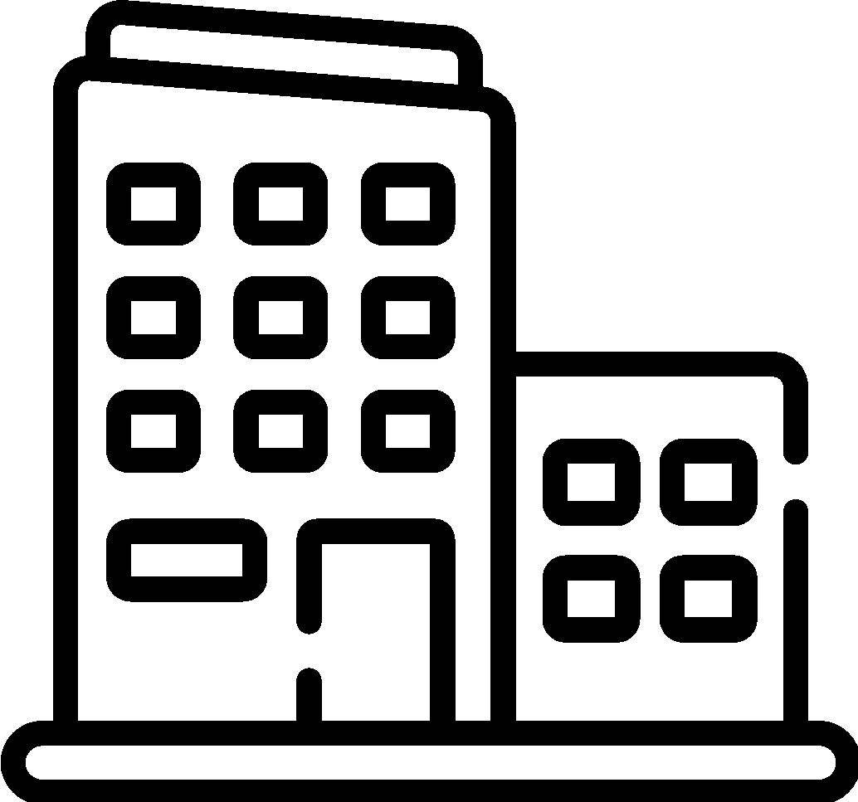
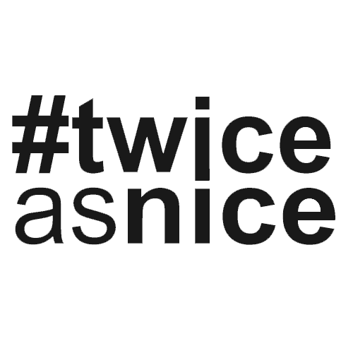
CASE STUDY
POWERING UP RECRUITMENT FOR AN ENGINEERING FIRM
THE CLIENT
The client creates crucial infrastructure to deliver electricity. As an engineering and design firm with decades of experience, they have helped power and internet companies deliver critical resources to the public.
From the Client Manager
THE ROLE
“We have been working with this client for a year and a half, and we have a really good idea of what we’re looking for and what flexibility may exist.”
Kristina Leege Client Manager
The power utility distribution designer would be responsible for end-to-end design for the delivery of electricity. The client needed someone with at least two years of distribution design experience in the electric and power industry. Instead of the “jack-of-all-trades” trope, we needed to find a master of one.
THE CHALLENGE
We have to turn the lights on for this search. For this client, we need to find candidates their internal recruiting team doesn’t find. While these are remote roles and the search can be done across the nation, there can still be candidate overlap. 50-75% of would-be candidates are typically rejected in these searches because the client has the candidates in their system. The challenge was finding a candidate the client didn’t know.
HOW #TWICEASNICE PARTNERED
Region
Midwest
The search had to be specific to find candidates within the industry. The talent pool can be shallow for these positions, so we thought outside of the box. The winning candidate has a background in telecom, but our senior recruiter saw how the candidate’s skills could benefit the client.
Industry
Critical Services
#TWICEASNICE RESULTS
Role
Power Utility Dist.
Designer II
This wasn’t our first rodeo, nor was it our first power utility distribution designer placement either. We’ve placed six designers for this client before. Despite searches with other recruiting firms, the client’s HR team says #twiceasnice Recruiting has the best handle on the candidate profile. Even with the specific requirements the client needed for this role, in under 100 days, the client had the perfect power utility distribution designer.
#twiceasnice Savings $9,921
Placement Guarantee 18-months
WE’D LIKE TO PARTNER WITH YOU
We help our clients save money and hire better with our custom-built searches, 9.9% fee, and 18-month guarantee. If you need to find a partner to work on your searches, contact us.
twonice.com
Save Money. Hire better.

